Slide 1
Template and generic programming
Generic programming is a style of computer programming in which algorithms are written in terms of types to-be-specified, later that are then instantiated when needed for specific types provided as parameters.
Through templates we can implement generic programming
The goal of generic programming is to write code that is independent of the data types.
if you want to add two integer variables, a function with two int parameters will work but now if want to add two float variables then we have to create different function for it.
we can just use templates to generalize the existing function to take both int and float values
A template is defined with the parameters that would be replaced by a specified datatype at the time of the actual use of the class or functions
We use two types of templates
function template
class template.

Slide 2
Function templates :
Syntax:
template <class T>
return_type function_name (argument of type T)
{ statements; }
Wap to perform max of two int, float and char using function template
Function templates with multiple parameters
We can define more than one parameter as a generic data type in the user define function templates
syntax:-
template <class T1, class T2,..>
Return_type function_name (argument of type T1,T2..)
{ statements; }
WAP to where function template takes two different data types and display the values
Overloading of templates function
template<class t1> template <class t1,class t2>
void sum(t1 a,t1 b,t1 c) void sum(t1 a,t1 b,t2 c)

Slide 3
class templates: It defines data member and member function templates
syntax:-
template <class T>
class classname
{ Class member specification };
Create object: classname <data type> object name;
Ex: student <int> s1;
WAP to create class template by defining two members of type T and perform all basic calculation
Class template with multiple parameter.
We can use more than one generic data type in a class template .
syntax:-
template <class T1 ,class T2>
class classname
{ Class member specification };
WAP to implement more than one generic data type in class parameter

Slide 4
Non type template argument
With type argument T we can also use other arguments such as strings ,function name ,constant expressions.
This template supplies the size of the array as an argument. So size of array is known to the compiler at the time itself.
syntax:-
template <class T ,int size>
class classname
{ Class member specification };
WAP to print the elements of array using non type template with size 10
Exceptions
Exception are run time anomaly(problem) or unusual conditions that is generated during execution of program.
For ex. problem such as division by zero, access to array outside of its bounds.
When program encounters these types of exception it is important that it is identified and handle with effectively. So program execute smoothly.
ANSI C++ provides features to detect and handle exceptions

Slide 5
Exceptions are two types synchronous exception and asynchronous exceptions.
synchronous exception:- out of range index, over flow.
asynchronous exception:-errors beyond the control of program.(keyboard interrupts)
exception handling mechanism in c++ handle only synchronous exceptions.
exception handling mechanism.
C++ exception handling mechanism works on three keywords try, throw and catch
try:
It is block of statements which may generate exceptions.
Exception is thrown using throw statement in the try block.
throw:-
Syntax: throw exception;
throw;
When exception is thrown it will be caught by catch statement associated with try block.
catch:-
Syntax: catch(type argument)
{ statements for managing exceptions. }
type :- indicates the type of exception that catch block handles.
argument :- is optional parameter name

Slide 6
when try block throws an exception program control leaves try block and enters the catch statement of the catch block.
If type of object thrown matches argument type in catch statement then catch block is executed for handling exception.
If they do not match program is aborted(terminated).
try {
throw exception;
}
catch(type argument)
{ statements; }
Wap to throw exception whenever value becomes zero
Multiple catch.
It is possible that a program has more than one condition to throw exception then we can use more than one catch statement with try .
syntax:-
try {
throw exception;
}
catch(type1 argument) when exception is thrown the exception handlers are
{ statements; } searches in order for appropriate match
catch(type2 argument)
{ statements; } The first handler that match is executed

Slide 7
WAP to implement multiple catch by throwing exception of different data type
Catch all exception
In some situations we may not be able to predict all possible types of exception.So force a catch statement to catch all exceptions instead of using multiple catch.
syntax:-
catch(…)
{ Statements for all exceptions; }
Implement the above program using catch all block
Rethrowing exception
When exception is rethrown it will not be caught by the same catch statement or any other catch in that group. Rather it will be caught by appropriate catch in the outer try/catch sequence only.
A catch handler itself may detect and throw an exception.
Wap to rethrow exception in catch block
Specifying exception
It is possible to restrict a function to throw only certain specified exceptions.
It is done by throw list to the function definition

Slide 8
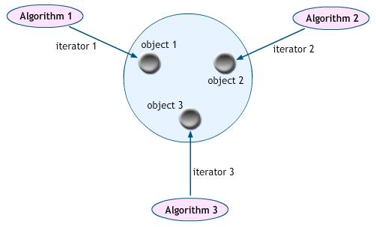
syntax:-
Return_type function(argument list) throw (type list) { }
The type list specifies the type of exceptions that may be thrown. If we wish to prevent function from throwing any exception ,then we can write type-list empty.
return type function(argument list) throw () { }
WAP to throw exception of type int and double by specifying in type list
Standard Template Library(STL)
The collection of generic classes and functions is called the Standard Template Library(STL).
STL components which are now part of the standard C++ library are defined in the namespace std.
Components of STL:
1. Containers
2. Algorithms
3. Iterators

Slide 9
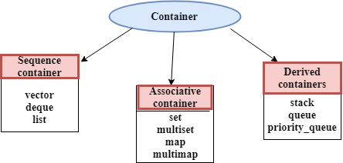
1. Container:
container is a object that actually stores data. It is a way data is organized in memory. STL containers can hold different types of data. There are three type of containers
Sequence containers: It store elements in a linear sequence.
Ex: vector, list, dequeue
Associative containers: It store data in a structure called tree
So we can direct access to elements. They are not sequential.
Ex: set, multiset ,map, multimap
Derived containers: It can be created from different sequence containers.
These are also known as container adaptors.Ex: stack ,queue ,priority_queue.
2.Algorithm:
Algorithm is a procedure that is used to process the data contained in the containers
STL algorithms may be categorized as
◦ Retrieve or non mutating algorithm Ex: count() –counts occurrence of a value in a sequence
◦ Mutating algorithms. Ex copy()-copies a sequence
◦ Sorting algorithms. EX: sort() – sort sequence.
◦ Set algorithms. Ex:-set_union ()- produces sorted union of two ordered sets.
◦ Relational algorithms. Ex: max()- give maximum of two values.

Slide 10
3. Iterator: points to element in a container. Iterators to move through the contents of containers. They are used to traverse from one element to another. We can increment or decrement them. There are five types of iterators
Container Vector: it supports random access iterators .We can create object using this syntax:
Vector <int> v1 ;
Vector class supports several function(algorithm) .
◦ back()- gives a reference to the last element.
◦ begin()- gives a references to the first element.
◦ insert()-insert elements in the vector.
◦ push_back()- adds element to the end.
◦ size()-gives the number of elements.
Wap for vector container
Iterator | Direction of movement | I/o capability
Input | Forward | Read only
Output | Forward | Write only
Forward | Forward | Read/write
Bidirectional | Forward and backward | Read/write
Random | Forward and backward | Read/write

